Slide 1
Medical Terminology: Human Disease Project
This presentation is based on Type 2 Diabetes as the selected Medical Terminology

Slide 2
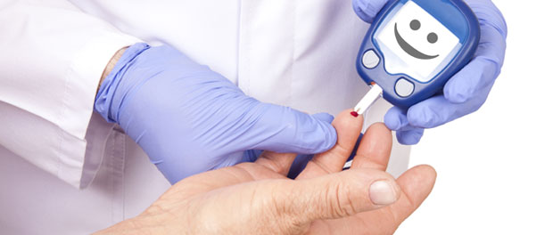
The Disease
Type 2 diabetes also generally identified as non-insulin dependent diabetes is a disease which has chronical effects on the pancreas and results in the lack of generation of the insulin, or it works to prevent the body from efficiently making use of its insulin.
The complications linked to Type 2 diabetes including:
  Stroke that damages the nervous system,
  Heart attacks,
  Kidney failure,
  Infections from bacteria,
  viruses in the eye, ears, skin, and mouth,
  Pregnancy complications (Centers for Disease Control and Prevention, 2011)
Notes:
Diabetes was initially realized in people who were beyond the age of forty and was regarded as adult-onset disease. Nevertheless, the disease was generally recognized among young adults and children. According to author children and adolescents account for approximately 30% of cases that involve diabetes. Type 2 diabetes affects both children and adults disproportionately.

Slide 3
Signs and Symptoms
According to the American Diabetes Association (2004), diabetes usually occurs gradually after a while, and the symptoms that are linked with it is sometimes not evident for a while.
Various signs of type 2 diabetes includes:
  frequent urination,
  fatigue,
  blurred vision,
  numbness and pain in joint places,
  thirst,
  loss of weight.
Some severe complications that result from Type 2 diabetes decreases a person’s life expectancy for well over five years for adult individuals
To diagnose type 2 diabetes, an individual is expected to go through lab test procedure that measures the level of glucose in the blood.
To know whether a person has type 2 diabetes, it is essential to test the blood glucose level. The measurement methods are such as
  Oral glucose tolerance test,
  Hemoglobin A1C test,
  Fasting plasma glucose.
Notes:
Type 2 diabetes is more often preceded by prolonged asymptomatic hyperglycemia which can last for years. During this state, postprandial levels elevate to a mild level while fasting blood glucose is usually maintained within a near-normal level. When the glucose level raises, this is defined as impaired glucose tolerance.

Slide 4
Cure
Changing Lifestyle and Diet
Tablets
Changing lifestyle habits is the most successful method for treating type 2 diabetes.
Balancing the metabolic level should be easily achieved through altering one’s lifestyle, and diet medication may not be required in this case
The mainly preferred method of treatment involves managing ones physical body and being able to create a balanced lifestyle and Diet
Curing type 2 diabetes through tablet often takes metformin and sulphonylureas (Laaksonen et al. 2005)
Different roles played by this agent in treating the tolerance of glucose are not apparent.
Notes:
There are no clear-cut regulations that involve including verbal hypoglycemic agents; the option depends on the specific person features and mechanisms of actions that are available. Curing type 2 diabetes through tablet often takes metformin and sulphonylureas. However, the mainly preferred method of treatment involves managing ones physical body and being able to create a balanced lifestyle and diet.

Slide 5
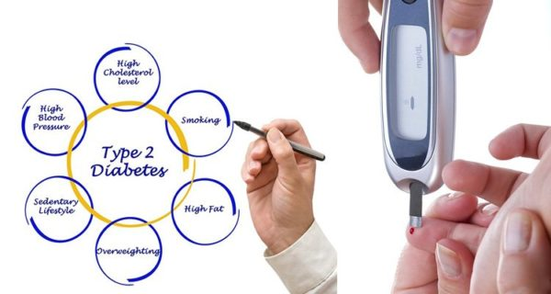
Why I selected the disease
Type 2 diabetes has received a great deal of attention over the past few years.
Managing insulin resistance and risks for cardiovascular is of great importance.
Type 2 diabetes can be prevented by eating wisely and engaging in regular activities, and even though it can be serious, it is ultimately preventable and can also be cured.
I chose this disease because managing it is important and requires research to enable those at risk to balance their glucose levels.
Notes:
Today, type 2 diabetes is gaining more attention because it is becoming common in society. The recognition stems from the fact that a healthy diabetes diet is required since it is increasingly bad culinary habits along with inappropriate exercise that leads many people to develop the disease.

Slide 6
References
American Diabetes Association. (2004). Screening for type 2 diabetes. Diabetes care, 27(suppl 1), s11-s14.
Centers for Disease Control and Prevention. (2011). National diabetes fact sheet: national estimates and general information on diabetes and prediabetes in the United States, 2011. Atlanta, GA: US department of health and human services, centers for disease control and prevention, 201(1), 2568-2569.
Laaksonen, D. E., Lindström, J., Lakka, T. A., Eriksson, J. G., Niskanen, L., Wikström, K., ... & Ilanne-Parikka, P. (2005). Physical activity in the prevention of type 2 diabetes: the Finnish diabetes prevention study. Diabetes, 54(1), 158-165.

